Slide 1

Wooden Packaging

Slide 2
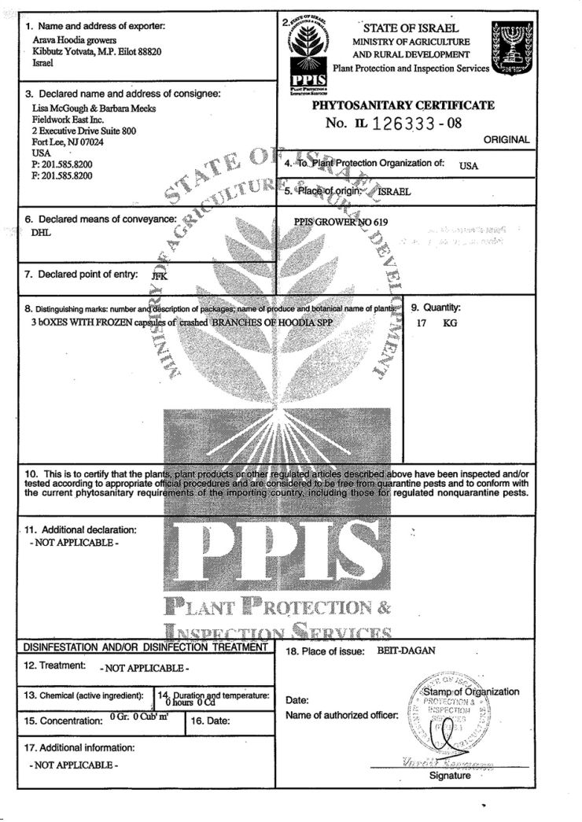
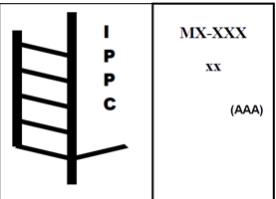
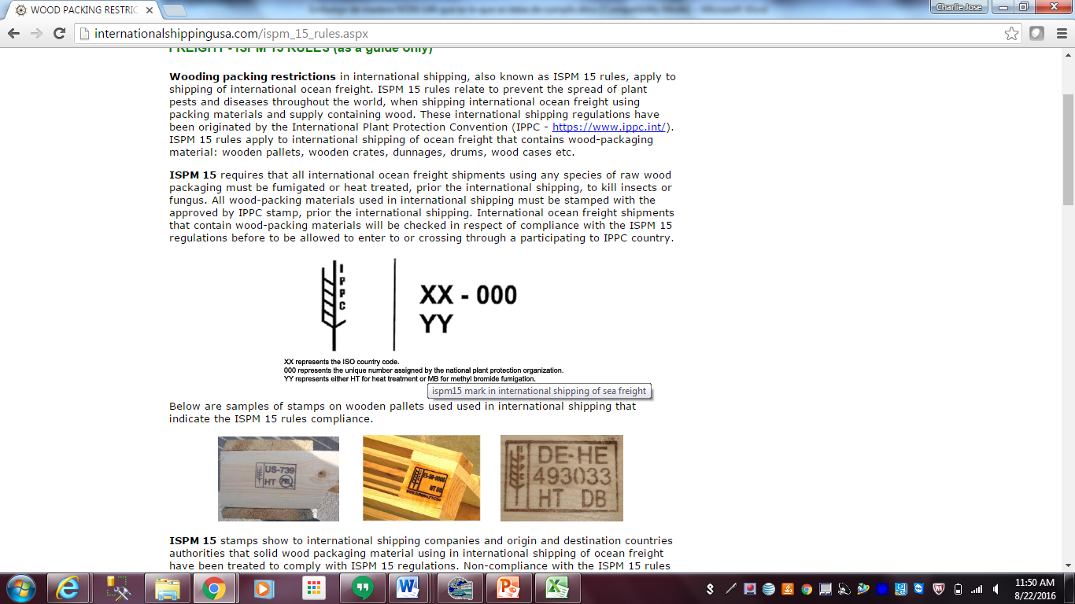
Wooden Packaging
The U.S. Department of Agriculture's Animal and Plant Health Inspection Service (APHIS) in USA and SEMARNAT in Mexico have established standards for wood packaging material (WPM) imported or exported out U.S. or Mexico through 7 CFR 319.40 and NOM-144-SEMARNAT-2004 regulations. These rule states that all regulated wood packaging material shall be appropriately treated and marked under an official program developed and overseen by the National Plant Protection Organization (NPPO) in the country of export, in accordance of ISPM 15 rules International Standards For Phytosanitary Measures.

Slide 3

NAFTA Certificate

Slide 4
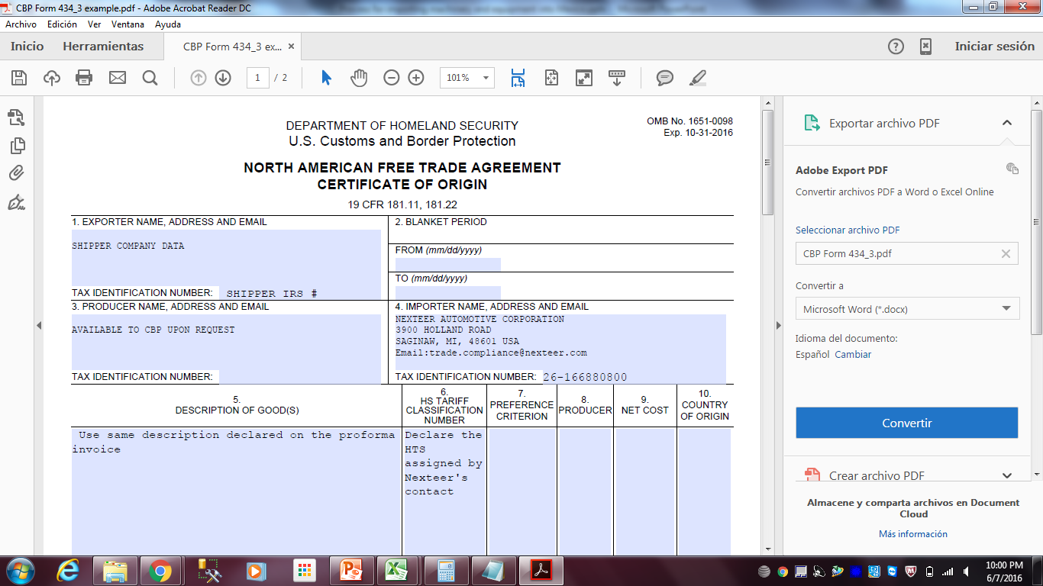
NAFTA Certificate of Origin for Mexico Customs
The certificate of origin is required only for main machinery or equipment and when the parts qualify for NAFTA benefits for USA, MX or Canada
Instructions by Field number
1.- Declare the shipper company data including Tax ID
3.- Declare “Available to CBP upon request
4.- Declare Nexteer Automotive full data
5.- Declare the same description used on the proforma invoice
6.- Declare the HTS provided by Nexteer’s classifier at six digits.
2,7,8,9,10,11,12 should be filled based on NAFTA certificate instructions.
The certificate should be sent to nexteerqual@sttas.com, trade.compliance@nexteer.com and jose.nova@nexteer.

Slide 5


Packing, Loading and Transportation
Requirements for Cross Dock
Inspection

Slide 6
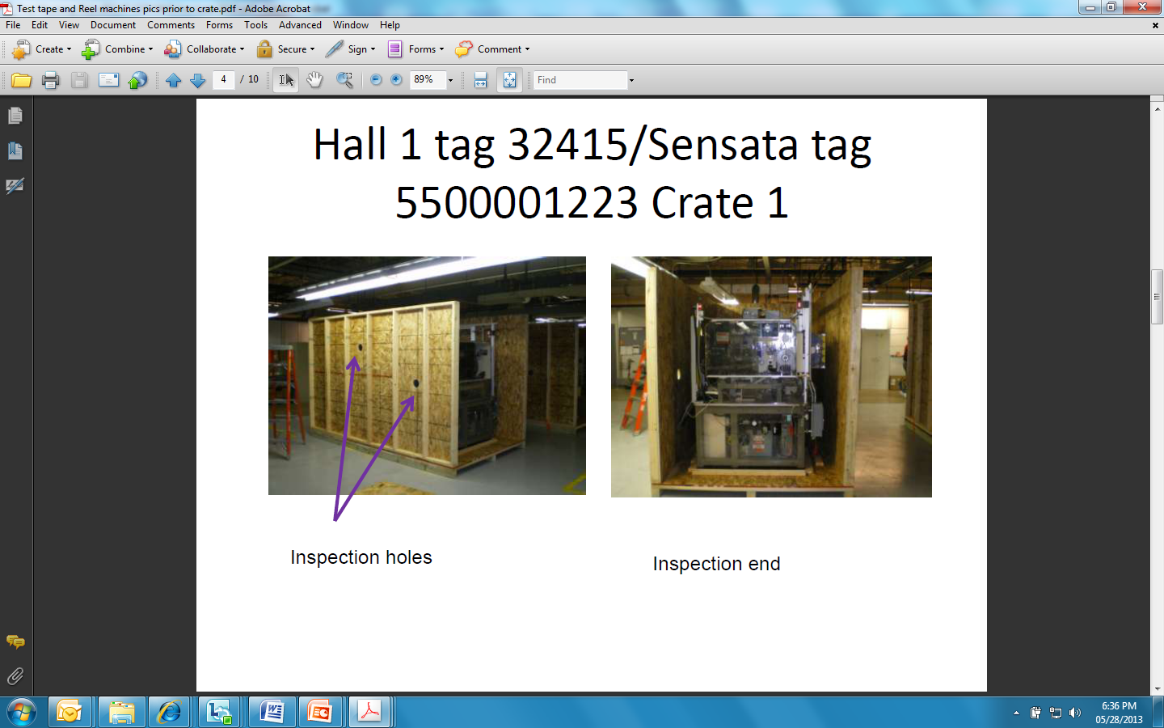
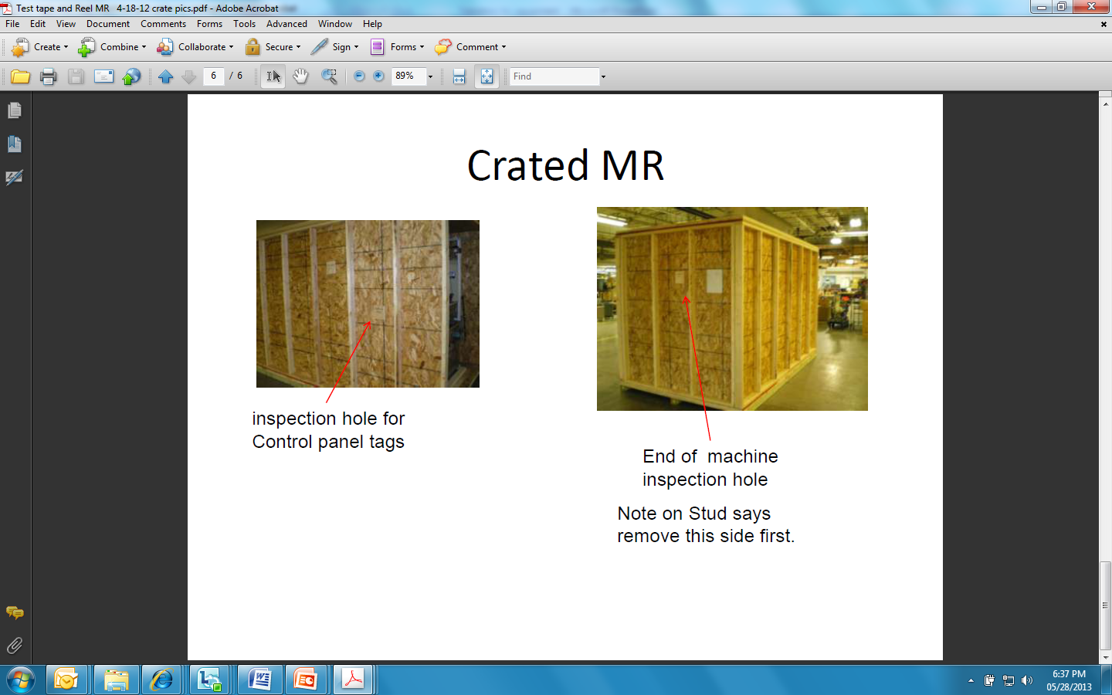
How to Pack the Equipment
The inspection holes should be where the individual identification plates are located.
Removable door required for double check at the cross dock
Crate or pallet should be identified with the skid number
The skid number have to match with the proforma invoice
SKID
3
Inspection holes and removable wall helps to speed out the MX custom broker inspection

Slide 7
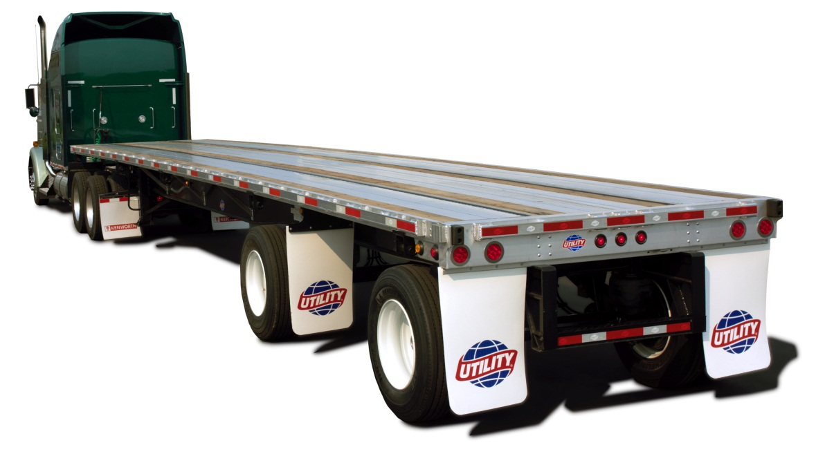
Suggested Loading of Equipment
4
The inspection holes and pallet identification should be on the side for easy inspection and to avoid unloading the crate
3
2
SKID
3
1
Main machine should be loaded very close to the doors
5
6
Individual spare parts should be loaded at the doors
Doors

Slide 8
Loading Map
Trailer Number 53125
5
1
Pallet # | Major Item | Length (IN) | Width (IN) | Height (IN) | Weight (Lb)
1 | Welding Machine | 60 | 60 | 58 | 218
2 | Computer | 48 | 40 | 31 | 372
3 | Oven | 48 | 40 | 50 | 228
4 | Stainless Steel Tables | 96 | 60 | 52 | 652
5 | Cart & Rack | 60 | 60 | 58 | 206
6 | Label Printers | 48 | 40 | 31 | 368
7 | Heater | 48 | 40 | 50 | 194
8 | Press | 96 | 60 | 52 | 623
2
3
3
4
6
8
4
1
3
2
1
7
2
Doors
The pallet number should be the same declared on the proforma invoice

Slide 9
Machinery Shipped in more
than One Trailer
There are some systems and machines that cannot be shipped into a single trailer
It’s very important to notify Nexteer when this scenario happens.
Please follow up below recommendations.
Ensure to ship machinery or system into a single trailer.
If the machinery and equipment cannot be loaded into a single trailer, then the trailers should arrive at the same time in order to be declared as single unit.
A proforma invoice will be required for each machine, although it was shipped into different trailers; however, is very important to identify on the proforma invoice which equipment is coming on each trailer.

Slide 10
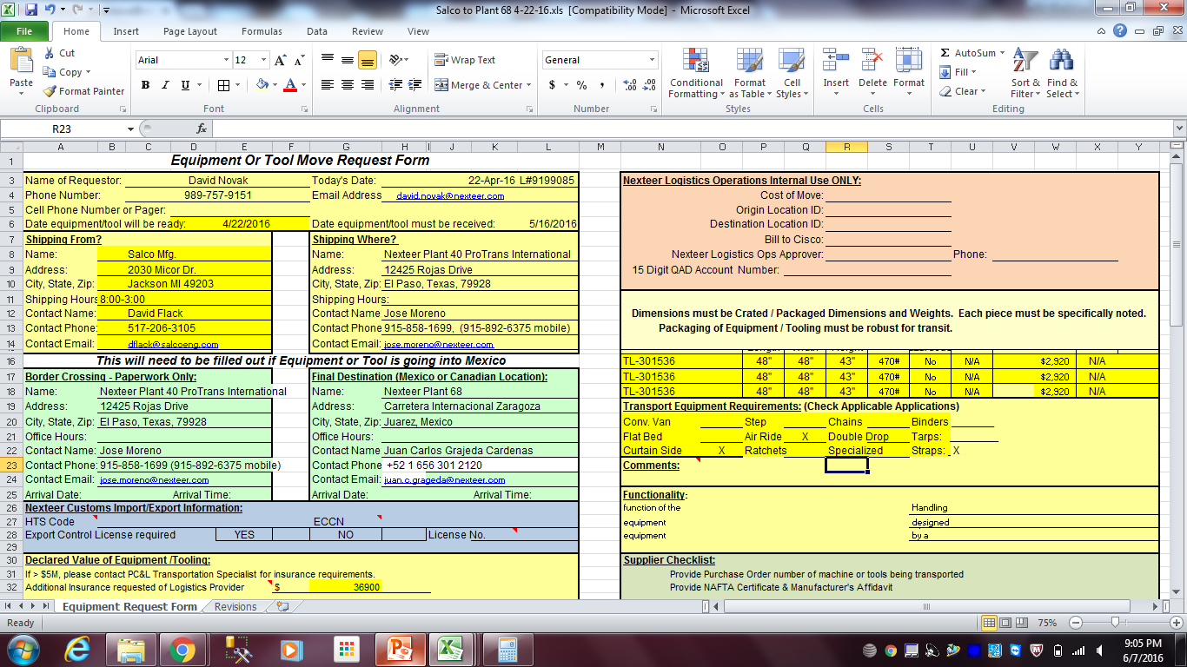
Equipment transportation form

Slide 11
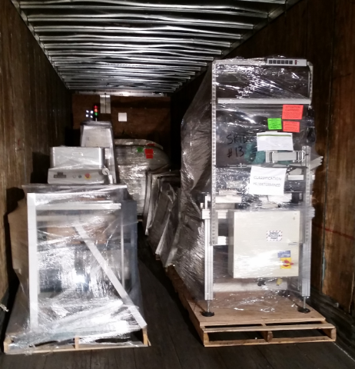
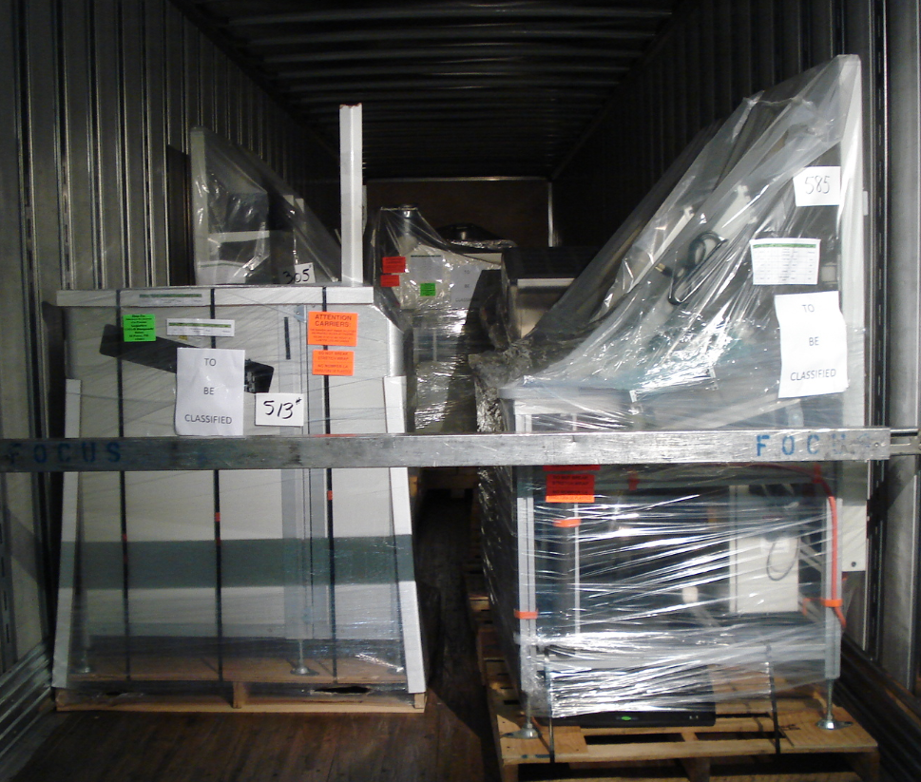
Provide Loading Pictures

Slide 12
Final release
Once all the documentation is completed, please forward below paperwork to the following email for shipment release
NexteerMXcrossboder@nexteer.com; machine.moves@nexteer.com;
Proforma invoice
NAFTA Certificate of Origin (if applicable)
Loading Map (transportation internal requirement)
Equipment Move Form

Slide 13
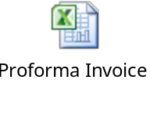
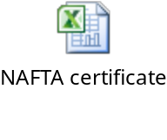

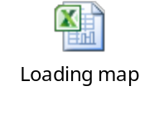
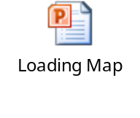
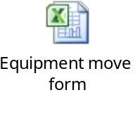
Templates
Use below templates as per your convenience
Proforma Invoice (Suggested Format)
NAFTA Certificate of Origin
Custom Tariff Classification Format
Loading Map
Equipment Move Form

