Slide 1
Legal Requirements to Import
Machinery and Equipment into Mexico

Slide 2
Guidance for Importing Fixed Assets into Mexico
Scope: This document describes all the shipping documentation and information required to support the Mexico Customs declaration for importing
Fixed Assets coming into Mexico.
The guide is divided in five sections:
Summary
Proforma Invoice Elements
Customs Tariff Classification
NAFTA Certificate
Packaging and Transportation Requirements
Templates

Slide 3

Documentation Overview

Slide 4
Mexico Customs Requirements
Please find below all the Customs documentation needed to perform the MX Customs declaration. The requirement is segregated in two groups.
Legal requirements:
Proforma invoice for shipping goods (It’s not an invoice for payment) legal requirement
Machinery and equipment’s individual identification data including Brand, model and serial number. legal requirement
Customs tariff classification number “MX and Schedule B” to support the Customs classification process will be required: technical data, machinery and equipment pictures legal requirement
NAFTA Certificate of Origin (If applicable)
Fumigated Wooden Packing legal requirement

Slide 5
Mexico Customs Requirements
Operational requirements:
Machinery and equipment identification plates
Loading Map (transportation internal requirement)
TAG number plate (finance internal requirement)

Slide 6

Proforma Invoice Elements

Slide 7
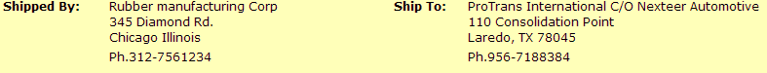
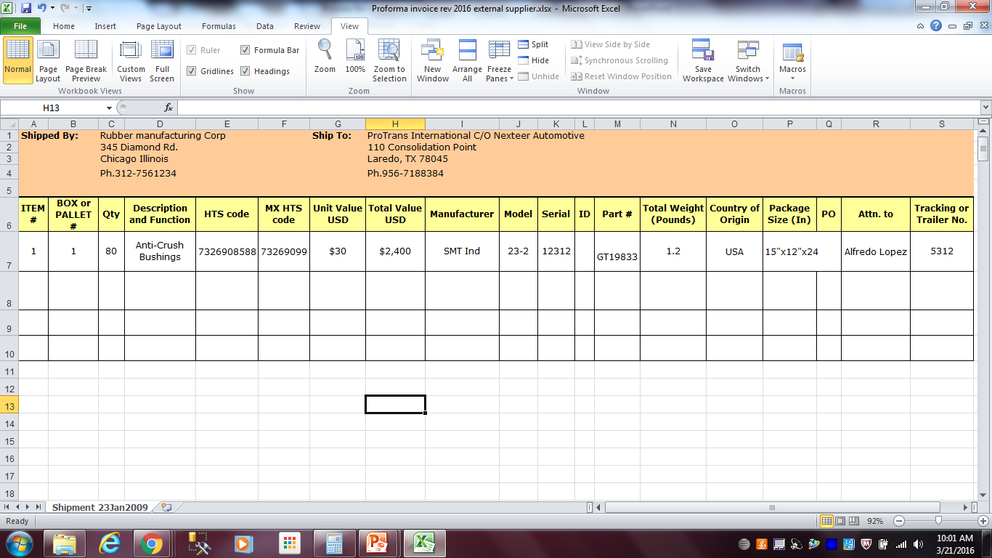
Proforma invoice – Information Required
Section 1
1.- Ship by: Company name, address, phone, contact, email and Tax ID.
2.- Ship to: if the final destination is Juarez if the final destination is Queretaro
ProTrans International C/O Nexteer Automotive ProTrans International C/O Nexteer Automotive
12425 Rojas Bldg. #1 110 Consolidation Point
El Paso, TX 79928 Laredo, TX 78045
Ph. (915) 858-1699 Ph. 956-7188384
3.- Item number: This number identify the sequence of the items shipped and has to be unique.
4.- Box or pallet number: This number identify the sequence of box or pallet shipped on the same trailer.
5.- Quantity
6.- Description and Function: Provide a full technical description of the item.
7.- Schedule B: It should be required to machine.moves@nexteer.com
8.- MX HTS code: It should be provided by NexteerMXcrossboder@nexteer.com
The proforma invoice has to be created by the shipper and send it on PDF file

Slide 8
Proforma invoice – Information Required
Section 2
Tag Number
SD-252314
9.- Unit and Total value: Declare the PO value OR Market value based on the current equipment conditions, Book value is not acceptable for Customs.
10.- Individual identification data: Declare Brand, Model, Series or ID (usually it’s contained on the identification plate).
11.- Total weigh: Item weight in pounds.
12.- Country of origin: The country where the machinery or equipment was manufactured originally.
13.- Package size: The size of the box or pallets in inches.
14.- PO
15.- Attention to: The person who will be the internal point of contact with Customs and PCL area.
16.- Trailer or tracking
17.-TAG number: Nexteer identification number for a Fixed Asset, auxiliary equipment and tooling's.
18.- Shipper’s signature
Please fill out one proforma invoice per trailer

Slide 9

How to List the Machinery and Equipment on the Proforma Invoice

Slide 10
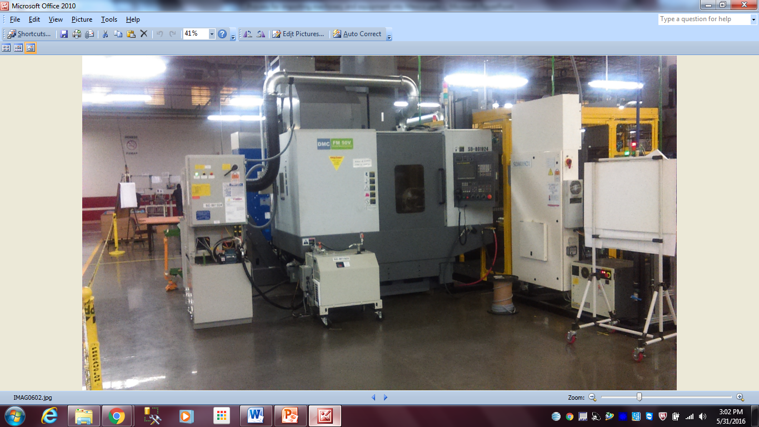
How to List the Machinery and Equipment on the Proforma Invoice
In order to perform a correct declaration for Mexico Customs the proforma invoice has to describe the following elements:
The main system or machine
All the auxiliary equipment linked to the main machine or system
All the tooling
All the spare parts shipped individually or disassembled
For example: Shipping a Tube cutting and milling system

Slide 11
How to List the Machinery and Equipment
on the Proforma Invoice
Description: Tube cutting and milling system
Section 1
Touch panel for Tube cutting system
Control panel for robot arm
High Pressure coolant and Mist collection system
Control panel for High Pressure coolant and Mist collection system
Hydraulic Unit for Tube cutting system
Transformer for robot arm

Slide 12
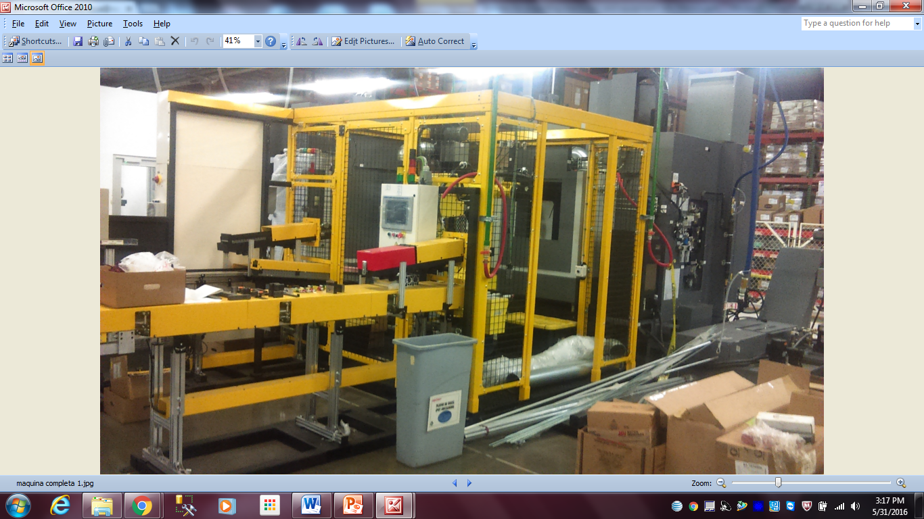
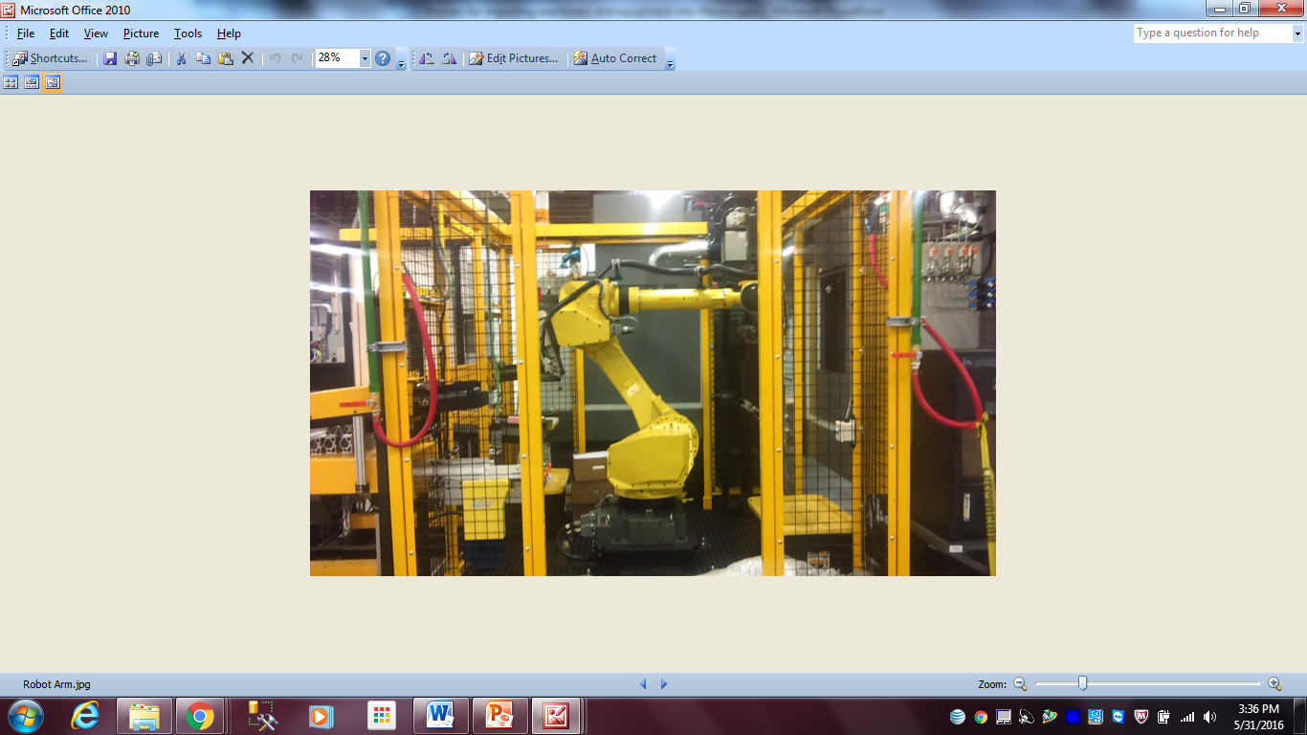
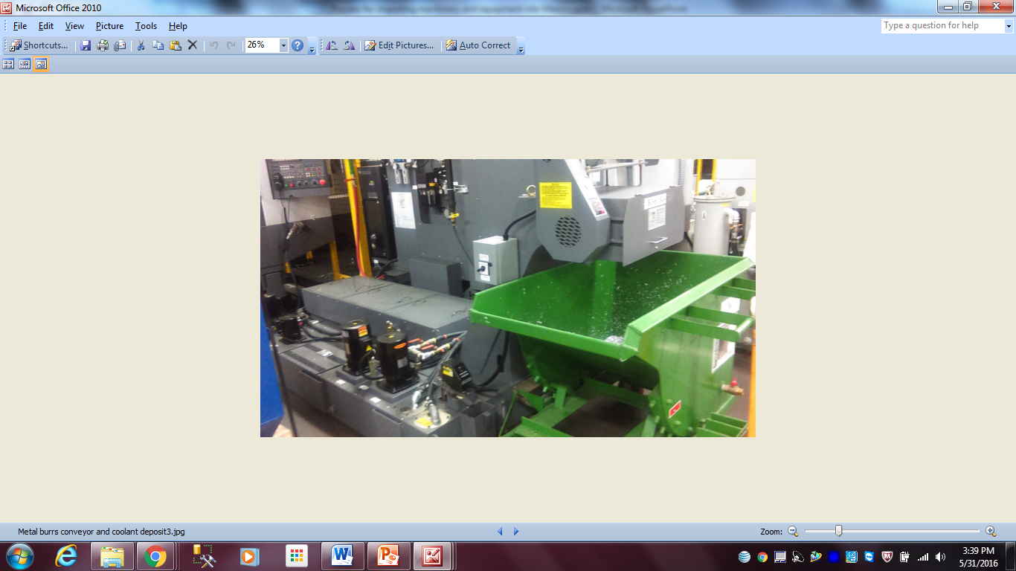
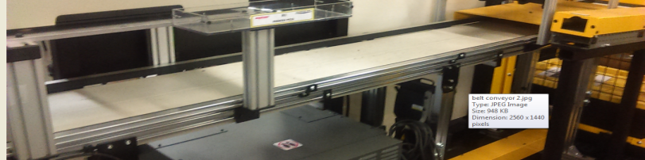
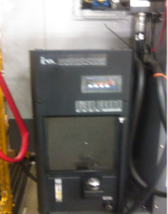
How to List the Machinery and Equipment on the Proforma Invoice
Description: Tube cutting and milling system
Section 2
Touch Panel for Robot Arm
Robot Arm
Rollover conveyor
Belt conveyor
Temperature regulator
Metal burrs conveyor and coolant deposit

Slide 13
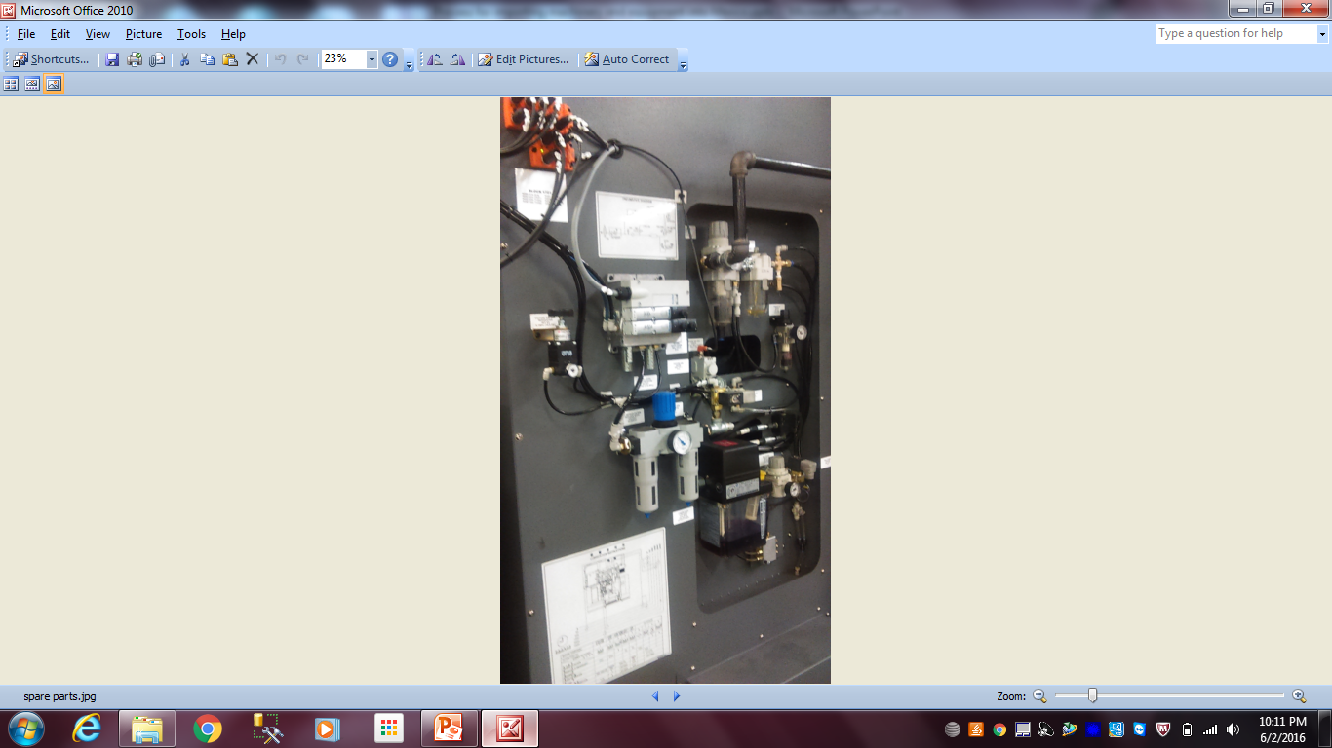
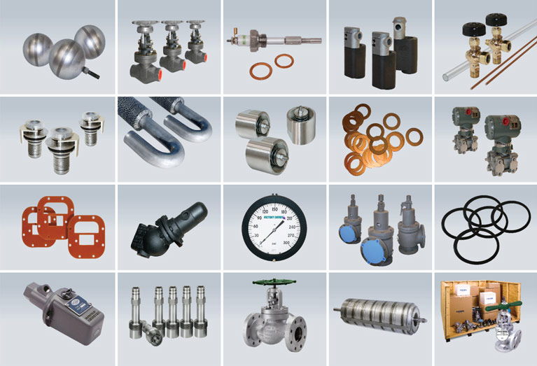
How to List the Machinery and Equipment on the Proforma Invoice
Description: Tube cutting and milling system Spare parts
If the spare parts are coming individually, they need to be listed on the proforma invoice with the standard information such as quantity, value, country of origin, description
On the other hand, if the spare parts are coming assembled on the machinery, they do not need to be listed individually

Slide 14
List of the Most Common Auxiliary Equipment and Spare Parts
Auxiliary equipment
Spare parts
Control Panel
Touch Panel
Power Supply
Temperature Control
Hydraulic Unit
Coolant System
Mist Collection System
Vacuum Pump
Belt Conveyor
Rollover Conveyor
Robot Arms
Printers
Scanners
Monitors
PC
Keyboard
Mouse
Valves
Switches
Regulators
Sensors
Hoses
Cables
Tubes
Screws
Nuts
Pins
O-rings
Connectors
Relay
Metal chain
Molds
Fixtures
Tooling

Slide 15


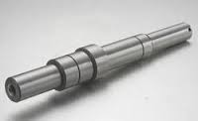
How to List the Machinery and Equipment on the Proforma Invoice
Description: Tube cutting and milling system
Pilot run samples or indirect material such as oil and grease
All the pilot runs, samples
and
Indirect material used for the machine
Should be treated as other items declaring all the information needed

Slide 16
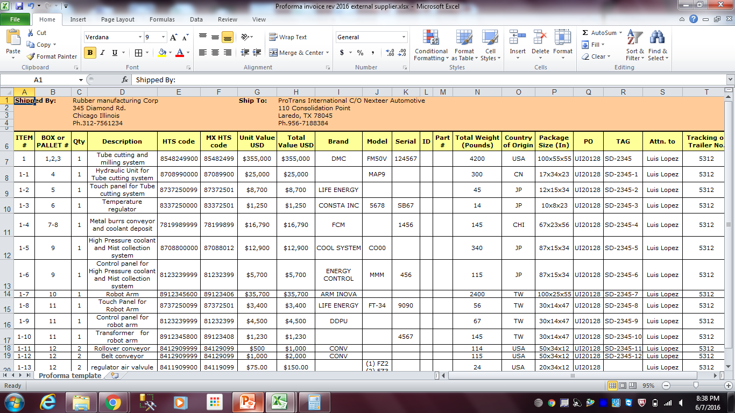
How to List the Machinery and Equipment on the Proforma Invoice
Tube cutting and milling system Final proforma invoice

Slide 17

Customs Classification Process
HTS

Slide 18
What Info is Required for Customs Tariff
Classification
Customs Tariff classification number (HTS): Is the numeric Customs code used to import and export merchandise from one country to another and is the unique code that determines the import duty and non tariff regulation like EPA or military permits.
Customs tariff classification process is very complex and follows several rules. Therefore, information below is needed for HTS determination:
Full Description
Technical data such as function and use
Specify if it’s part of something else
Material of item (e.g., steel, aluminum, etc.)
Pictures
Don’t be surprised if the Customs classifier asks for more information. Remember, some Customs classifications are determined based on your responses.
A contact with extensive knowledge on the technical data is require for assistance

Slide 19
How Provide Data for Customs Tariff Classification
The supplier should fill out the Customs classification format for the HTS assignment. The format requires the below information
Item number: This number identifies the sequence of the items shipped and has to be unique. This item number has to be the same as declared on the proforma invoice.
It’s part of the Item: Include the item number of the equipment
Description: Describe the item shipped. It should match with the description declared on the proforma invoice.
Main function: Provide full technical data about the main function of the item described.
Material made of: Describe the main material of which a item is made or composed being specific for example steel, iron, aluminum, stain steel, plastic, rubber, polycarbonate, glass…
Category: Describe if it’s Main equipment, auxiliary equipment, tooling or spare parts
Supplier contact: It’s the main contact who will provide additional technical data if it’s needed.
Picture: Include legible picture of the item
Identification plate: Include a picture of identification plate of the item

Slide 20
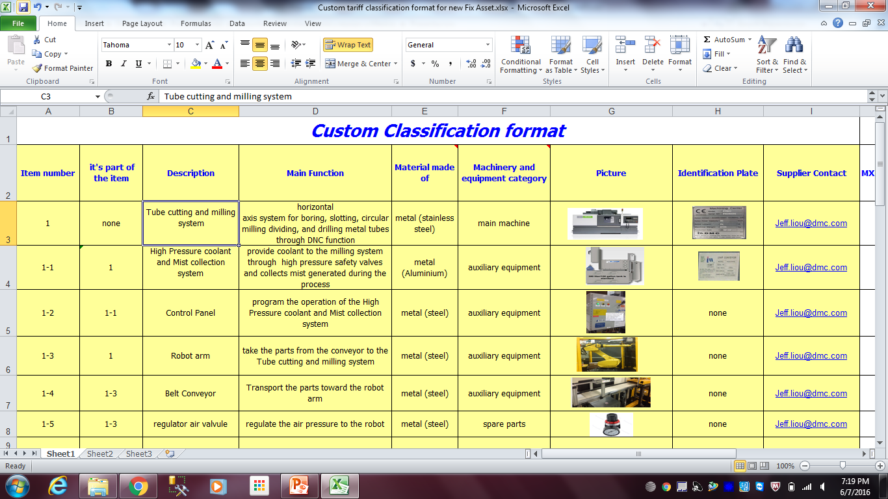
How Provide Data for Customs Tariff Classification
Once the Customs classification format is completed, send to the following contacts:
For equipment going to SteeringMex at Queretaro plants (63, 65 and 66)
NexteerMXcrossboder@nexteer.com; machine.moves@nexteer.com;
For equipment going to SteeringMex at Juarez plants (61 and 68) NexteerMXcrossboder@nexteer.com; machine.moves@nexteer.com;

