Slide 1


NEXTEER
GLOBAL SUPPLIER
CONFERENCE 2020

Slide 2
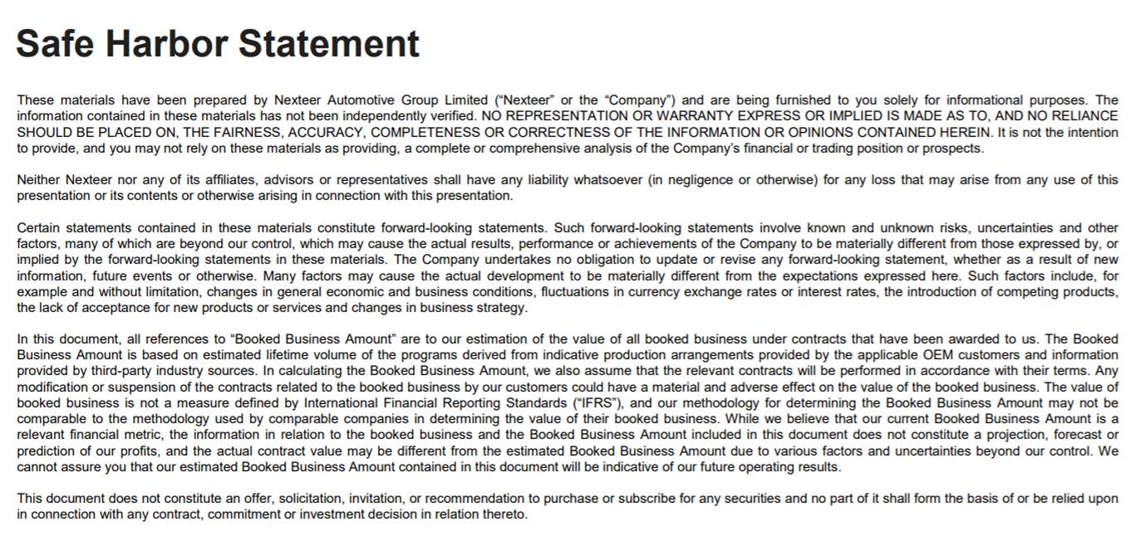

Slide 3

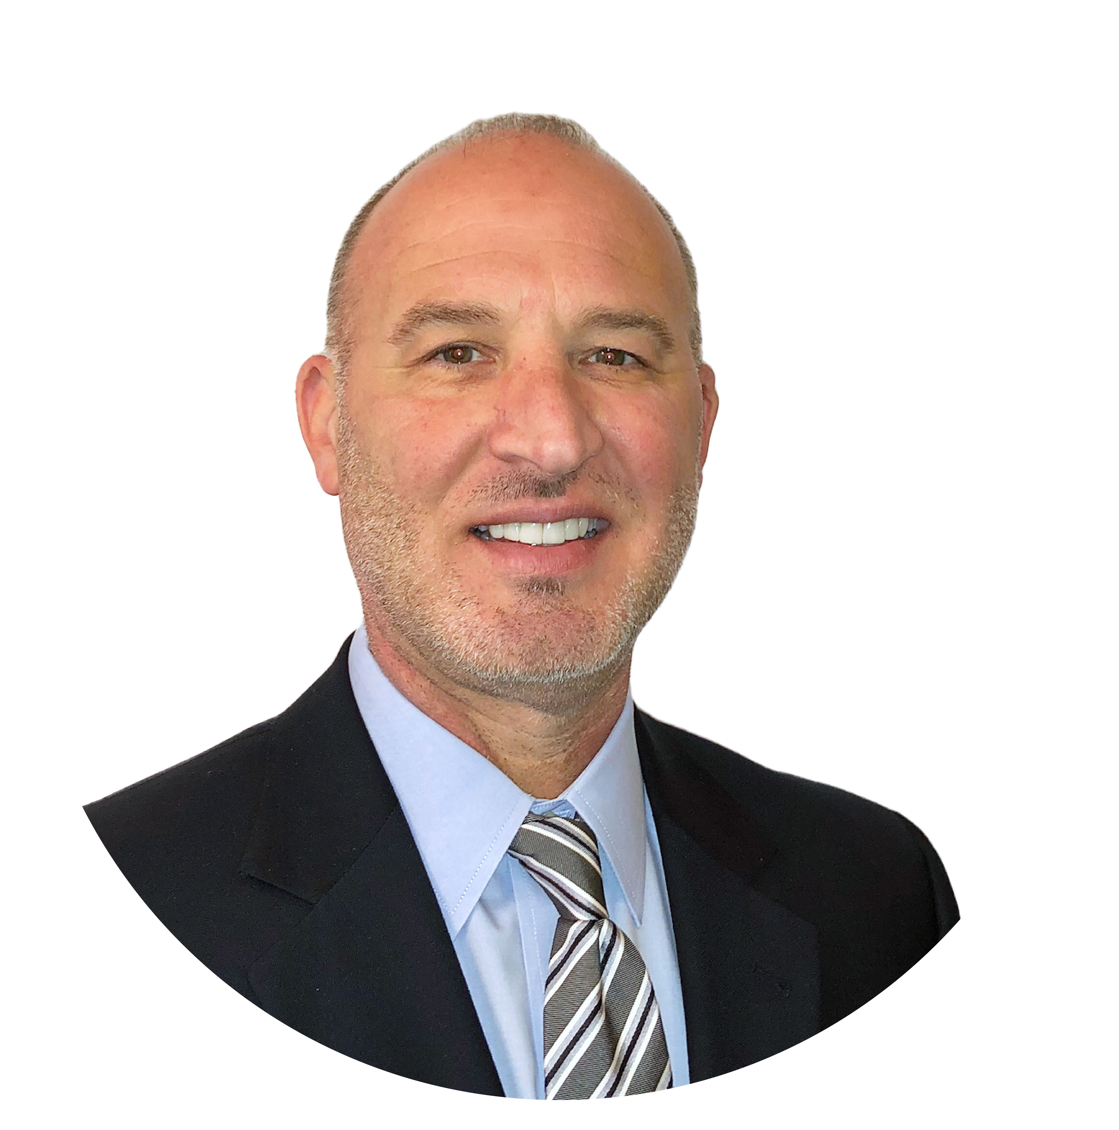
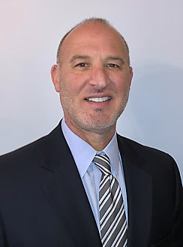
Sal Orsini
Executive Director,
Global Supply Management
OPENING
Notes:
Hello and Welcome to the 2020 Nexteer Global Supplier Conference.
I am Sal Orsini, Executive Director for Global Supply Management. For most of you, this is the first time I am getting the opportunity to introduce myself. I joined Nexteer in June. I come to Nexteer with over 20 years of Purchasing and Supplier Quality experience in both Automotive and Aerospace industries. I even spent 3 years in Saginaw earlier in my career when I was with Delphi. I spent the first half of my career with Delphi and then transitioned to the Aerospace industry working for Rolls-Royce. I also worked for General Motors in their Global Purchasing depart as a global Commodity Director. My career path has led me back to Nexteer and I could not be more excited about this role and this opportunity.
This is obviously and interesting time we live in today. This conference is different, just like many other things around us. We may not be in the same room together today, and the agenda is somewhat different from prior year conferences, but the purpose is still very important to us. We also have some special recognition to hand out later and we have some important messages to share with you today, as well.
So thank you for spending part of your day with us. I hope you find today informative and virtually collaborative.

Slide 4

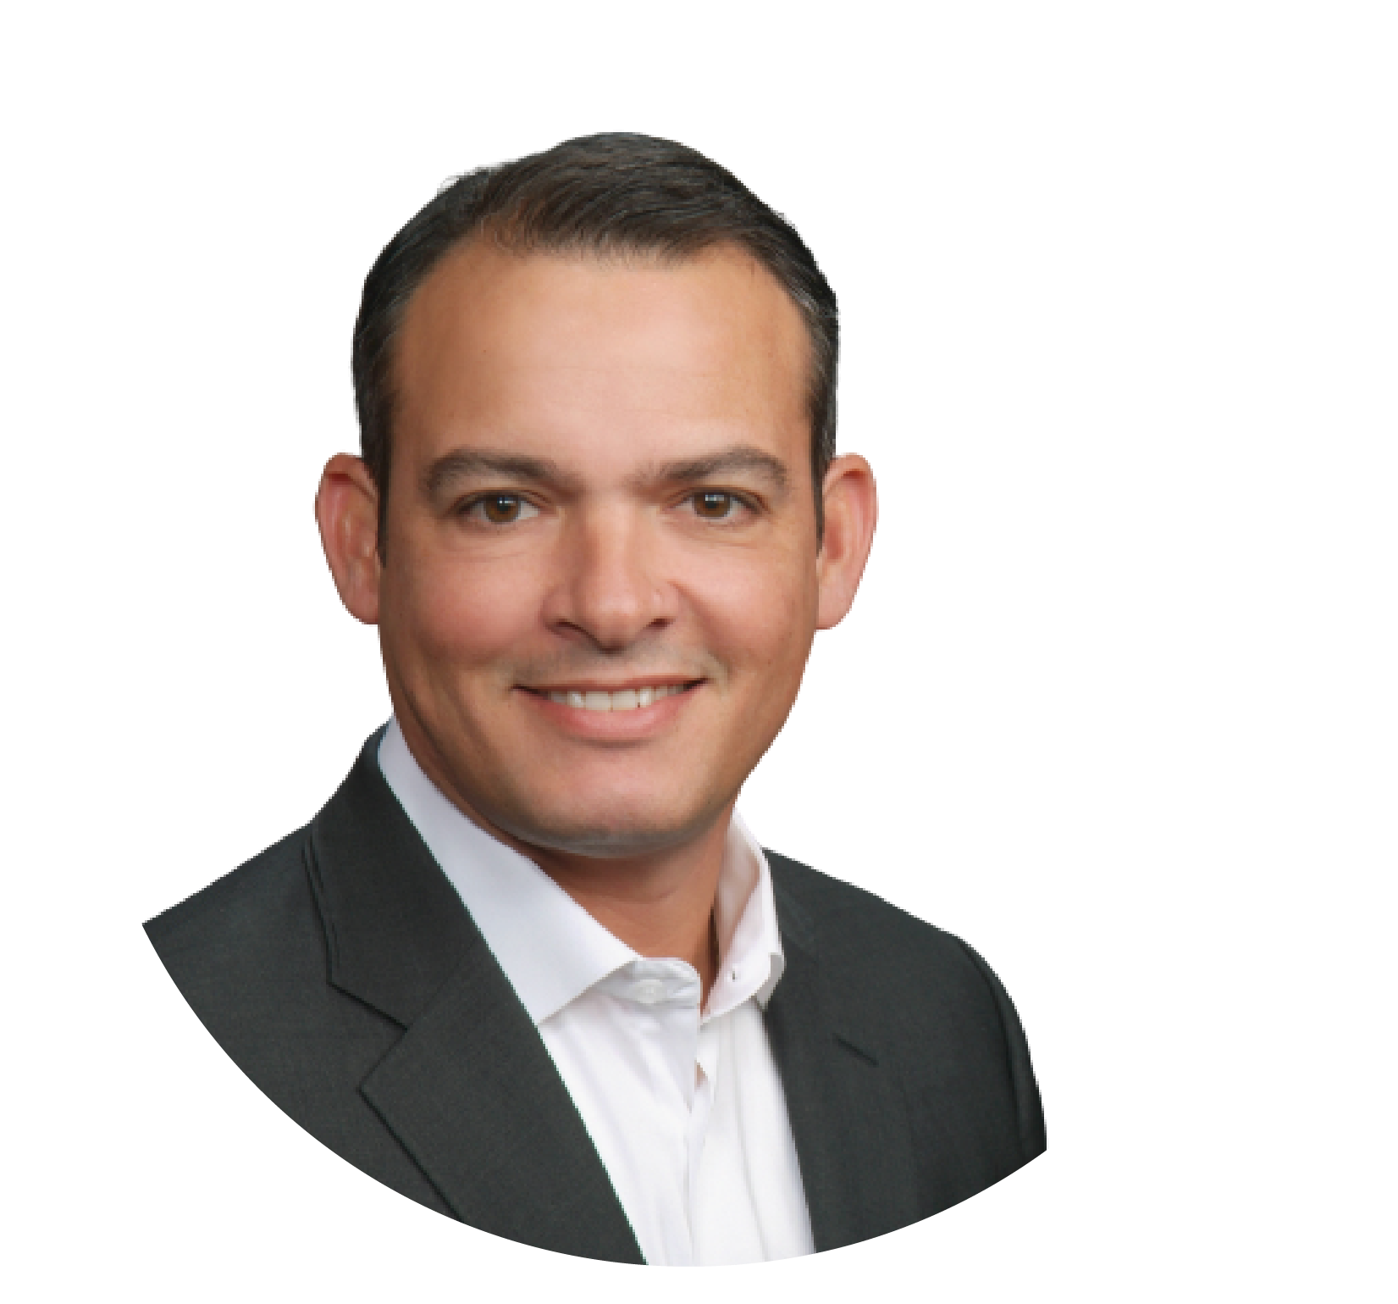

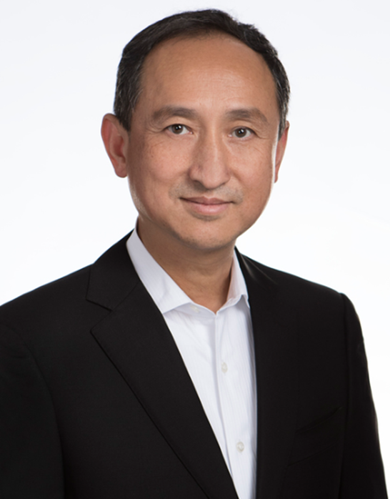

Tao Lui
SPEAKERS
SPEAKERS
President & Global COO
Sal Orsini
Executive Director, GSM
Notes:
We will kick things off with a welcome from Tao Liu our President and Global Chief Operating Officer.

Slide 5

OPENING – Sal Orsini
AGENDA
PRESIDENT’S MESSAGE – Tao Liu
STATE OF THE BUSINESS & GSM Update – Sal Orsini
SUPPLIER AWARDS & SPECIAL RECOGNITION
CLOSING
Notes:
The agenda for today is very focused and designed to be efficient.
So get ready and thank you, again, for your attendance. Please join me in welcoming Tao Liu, President and Global COO for Nexteer.

Slide 6
Tao Liu
President &
Global Chief Operations Officer
PRESIDENT’S MESSAGE

Slide 7

Welcome!!
2020 Global Supplier Conference
Notes:
As with many things this year, our conference is a little different than in prior years, but we feel it is still important to hold. We may not be in the same room together, but I am confident you will find todays conference valuable and informative.
We are excited to introduce you to our new global leader of GSM, Sal Orsini. Sal has over 20 years of experience in the automotive and aerospace industries and he even spent 3 years in Saginaw early in his career with Delphi. You will get a chance to hear a little more from Sal later.
2020 has been a year unlike any other that we have experienced together, unprecedented. Throughout this unprecedented time we remain grateful for the relationships we have with you, our supplier partners, and your resilience in dealing with these events, especially during the shutdown and restart of operations earlier this year.
As we look ahead to the fast-approaching end of 2020 and the beginning of 2021, we know there will be new challenges for all of us. And we know it is critical to have strong relationships to meet these challenges together. That is part of what Winning the Long Game means to Nexteer. Relationships are often tested over time and it is how we deal with those challenges together, that defines the strength of those relationships.

Slide 8
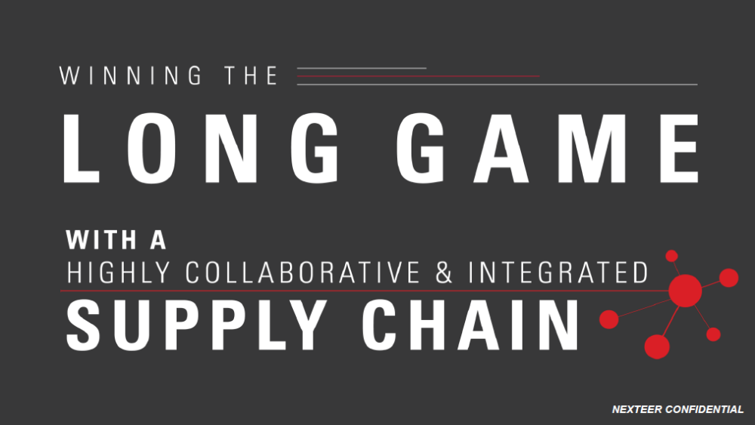
Notes:
So as you listen to the material that we are going to share with you today, I ask you think about what Winning the Long Game means to you and your company.//
The Long Game means reliability in delivering on time, launching on time with the right capacity, and it means delivering a cost competitive solution that positions us all to win in the market. As we look ahead to 2021, I ask you to think together with us, are we prepared to respond to the continued recovery of volume and revenue. We have all made changes to how we operate our companies and believe we have taken the necessary steps to be in the right position to accelerate through this new reality. We are looking forward and ahead of the curve to spot and seize on these opportunities. Ask ourselves, are we ready as we embark on this new reality? //
I am pleased to announce we have over 140 supplier locations that have met the criteria for the Perfect Scorecard Award this year. This is an outstanding accomplishment.//
I want to personally thank all of the winners today, we appreciate your commitment to excellence.
Finally, I want to take the opportunity to remind everyone that we are committed to the health and well-being of our employees, their families, customers and suppliers. Many of the protocols we put in place earlier this year are still in effect. So please continue to remain vigilant and safe. // Thank you!

Slide 9
Sal Orsini
Executive Director,
Global Supply Management
State of the Business

Slide 10

2020 Presented
Much More Than a “Headwind”

Slide 11
Unprecedented Times
We Have Not Experienced

Slide 12

Business / Financial Phases
React
Recover
Reality
Notes:
12

Slide 13
Business / Financial Phases
React
Work from Home Protocols
Orderly Manufacturing Shut-Downs
IT Infrastructure Reliance
Cash Management Top Priority

Slide 14


Unprecedented Environment
Light Vehicle Production Unit Volume Y-o-Y Change %
N. America
APAC
EMEASA*
1H 2020 vs 1H 2019
-40%
-26%
-41%
Industry Production Disruption Drove
Significant Revenue Decline in 1H 2020
* EMEASA includes Europe and South America

Slide 15

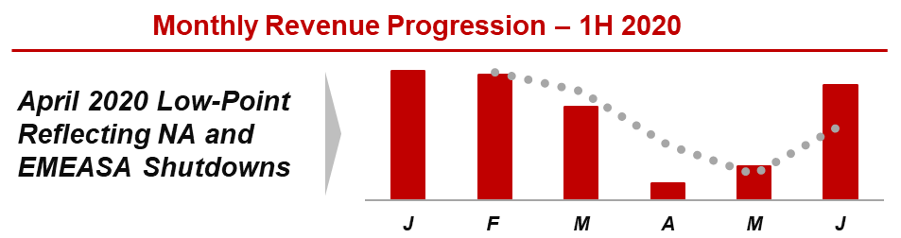
  Late May - Successful Production Restart
  in NA and EMEASA

Slide 16
Business / Financial Phases
Recover
Safe-Work Play Book
Customer / Supplier Coordination
Manufacturing Restart
Constant Communication
Cash Management Top Priority

Slide 17

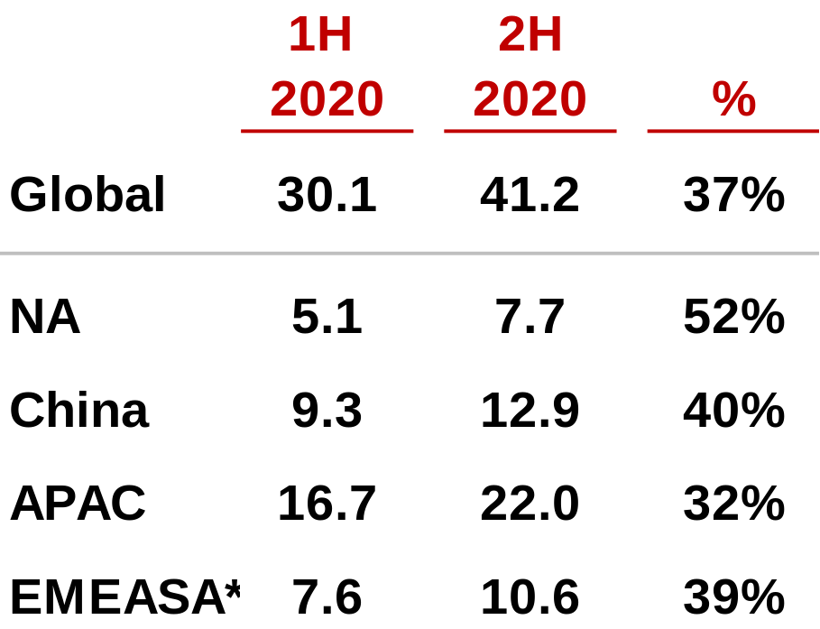
Green Shoots Evident
OEM Production Forecast
  (units in millions)
Sept 2020 IHS Markit Ltd. forecast
* EMEASA includes Europe and South America

Slide 18
Green Shoots Evident
2020 Revenue Expectation
+40% - 50%
Demand Benefits Us All!

Slide 19
Business / Financial Phases
Reality
2021 and Beyond
Slow / Stable Recovery Expected
Redefine Priorities
Cost Structure & Capital Allocation
Margin Recovery / Cash Flow

Slide 20

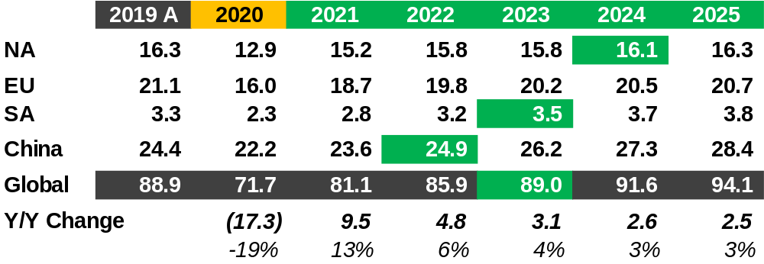

Industry Look-Forward
Current OEM Production Forecasts
Current OEM Production Forecasts
(in millions)
(Sep 2020)
= or > 2019
Multiple Years to Achieve 2019 Performance

Slide 21

Awareness
Resilience

Slide 22
GSM Update

Slide 23


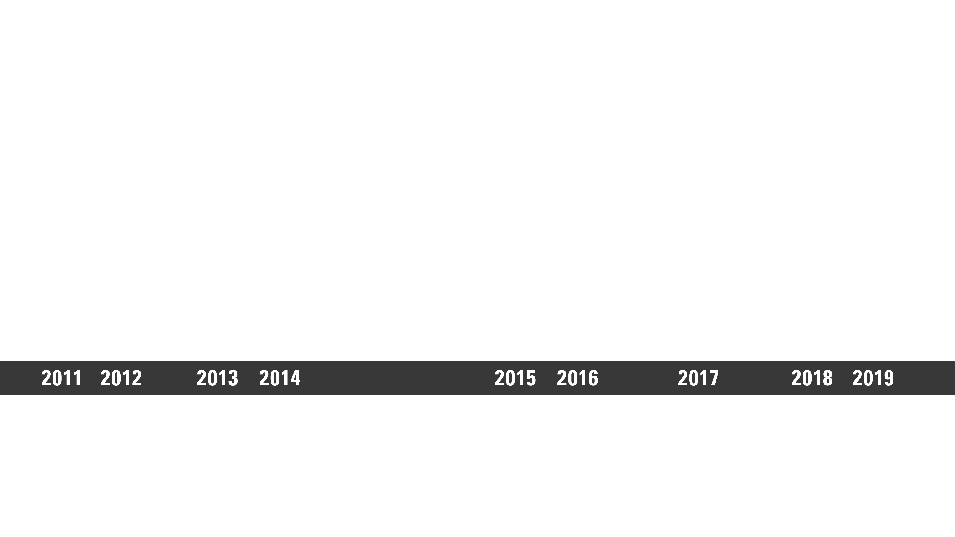
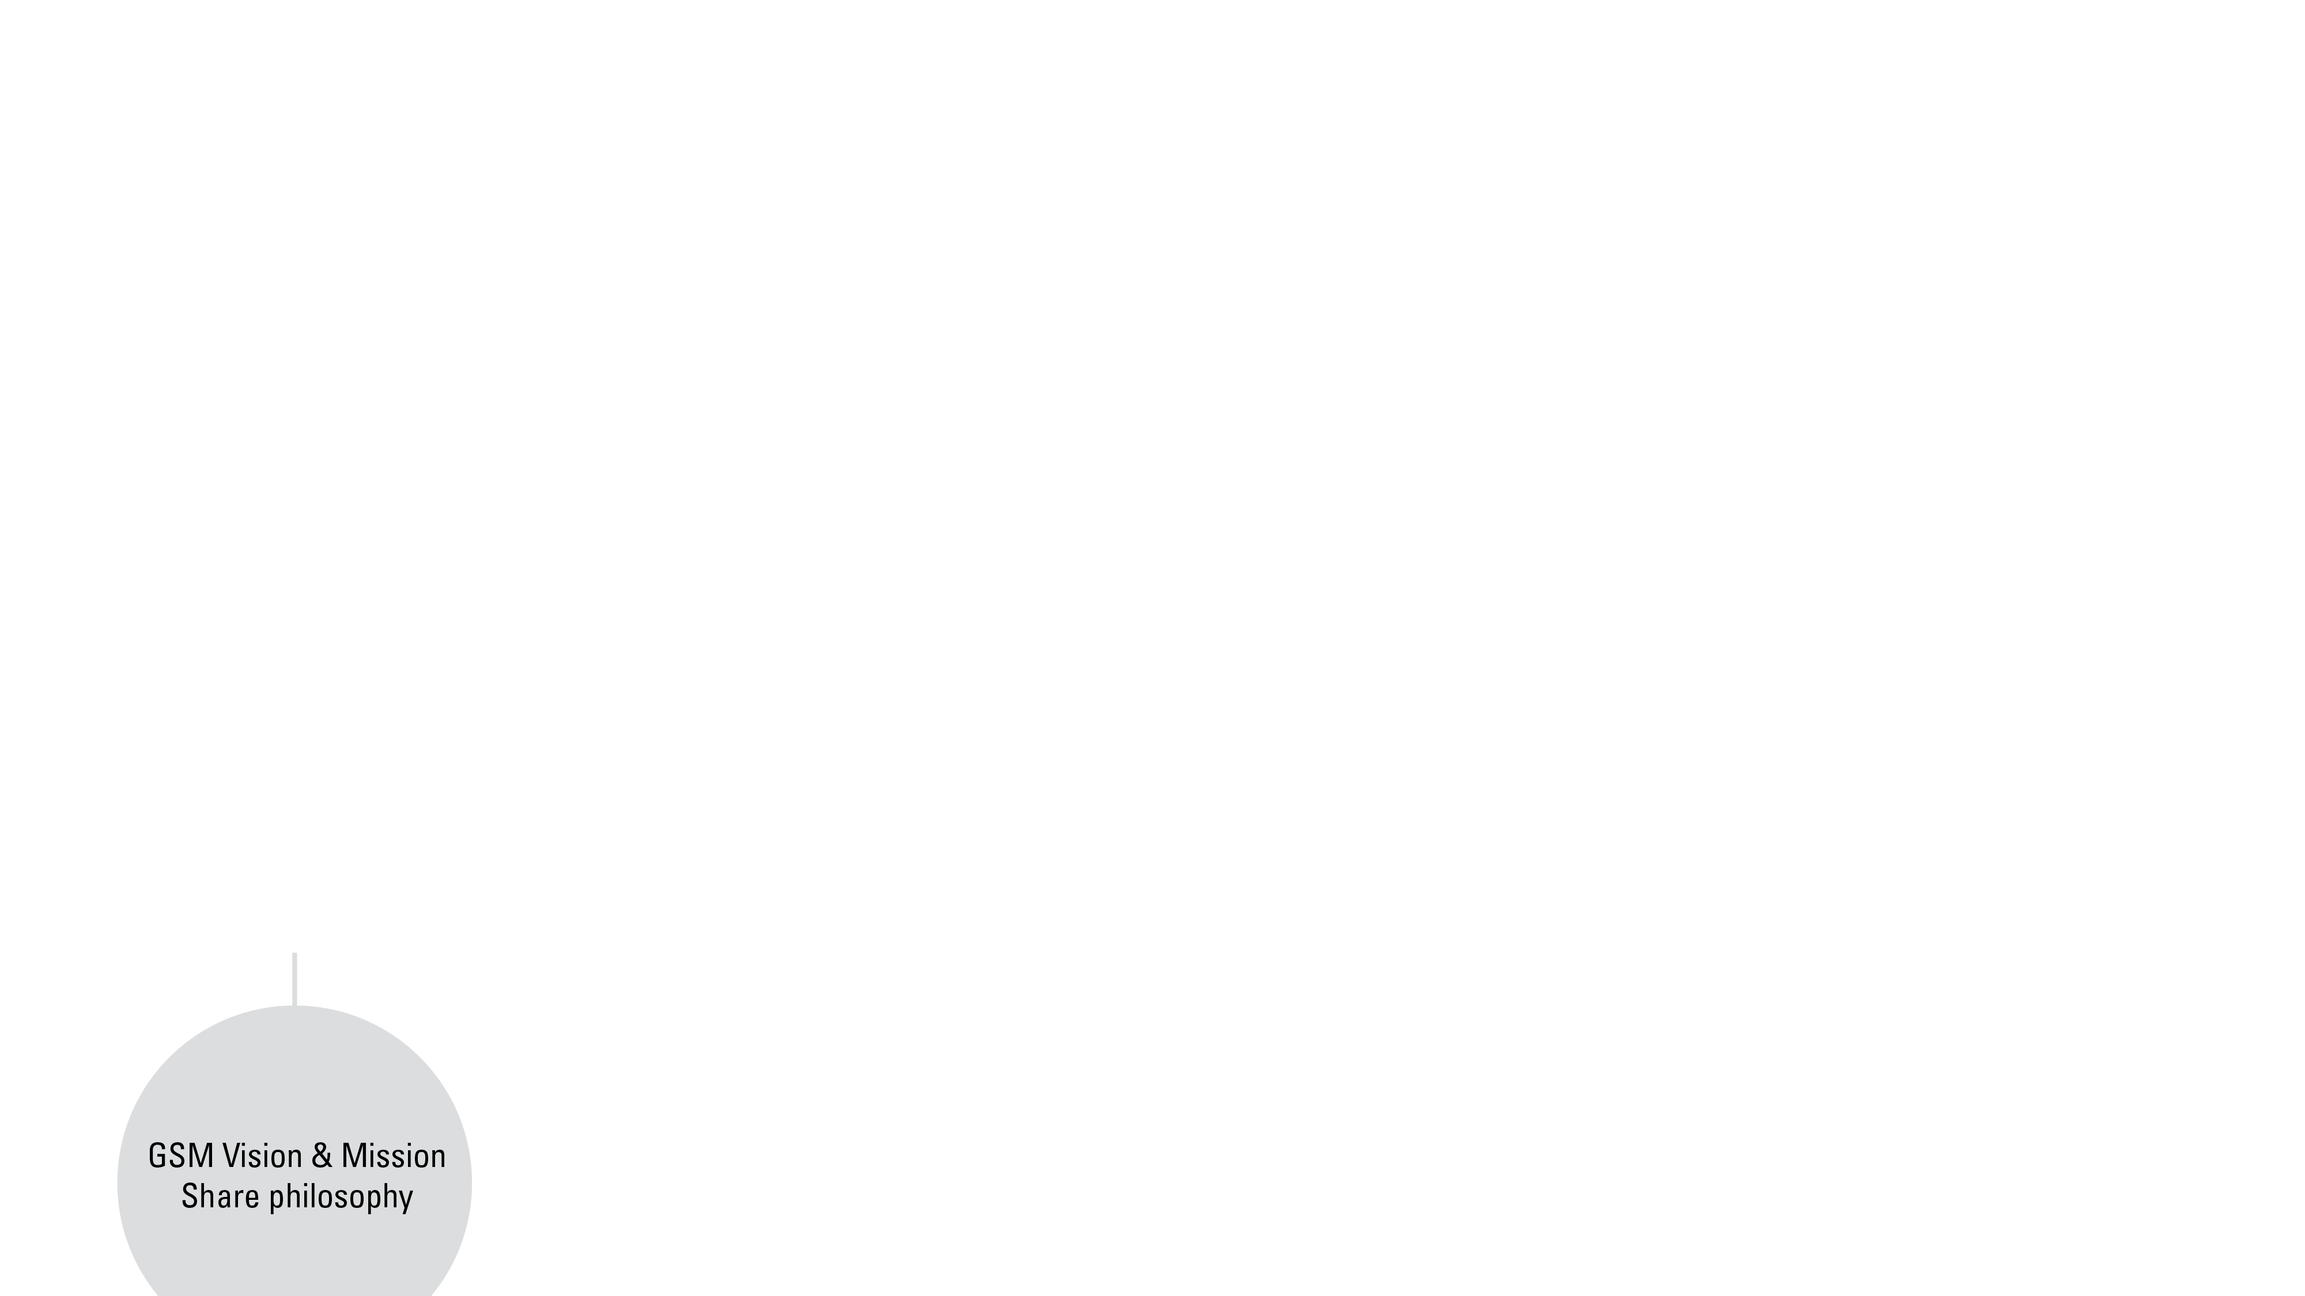

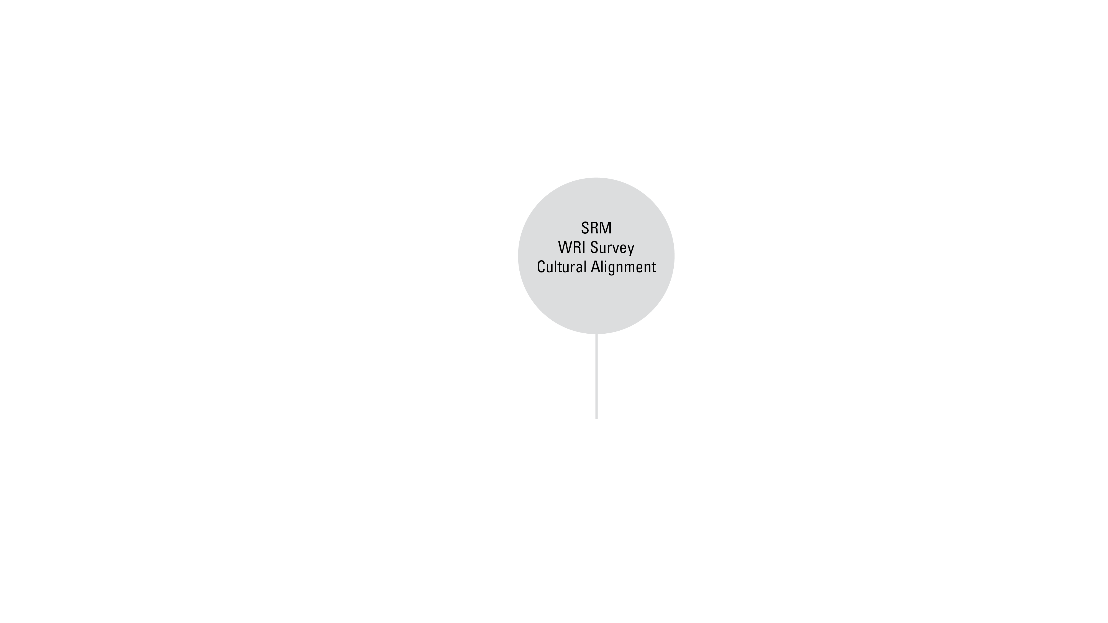

2020
Notes:
23

Slide 28
SUPPLIER AWARDS & SPECIAL RECOGNITION

Slide 29

Perfect Quality
Zero Problem Cases & Zero Defects
Delivered > 50 K Pieces to Nexteer locations
> $250K in Sales to Nexteer locations
Good standing for all: Certifications
147 Supplier Locations
All Commodity groups … Motors, Electronics, Castings, Machining, etc…
Many of our former TFS suppliers are included in the list
Notes:
Hi,
My name is Kurt Heberling and I’m the Executive Director of Global Supplier Quality and Development for Nexteer Automotive
I’m sure many of you have heard “Quality is a given” when it comes to Customer expectations. It’s true, but to deliver on this expectation requires significant effort and a Culture of Quality. Today it’s my great pleasure to recognize our Partners who have Achieved the Perfect Quality award this year
To qualify for this award, a supplier must meet all four of these criteria
Zero Problem Cases & Zero Defects (July 2019 – June 2020)
Deliver a minimum of 50 K Pieces
Achieve a minimum of $250K in Sales to Nexteer
All while maintaining the required Certifications
This year
147 Supplier Locations from every region are being recognized for this honor.
This is a 30% increase over 2019
Suppliers from every Commodity achieved this goal
Many of our former TFS suppliers are on this list now
Please take a few minutes and join me in recognizing these suppliers

Slide 30

PERFECT QUALITY

Slide 31



Superior Customer Service Award
Kimball Electronics Nanjing - COVID
  Kimball’s Nanjing operation was stopped due to COVID which had the potential to impact Nexteer plants in China, Mexico, India, and Brazil.
  Kimball made special efforts to allocate resources to support Nexteer business as local authorities allowed them to incrementally add manpower
  Kimball Nanjing allowed Nexteer Suzhou personnel to influence the production plan as Nexteer fed information from around the world and prioritized based on demand and inventory positions
  Nexteer was extremely close to interrupting OEM customer production but managed to avoid this through close coordination and superior customer service
Kimball Electronics corporate – Nexteer Visibility Information System
  Kimball global Supply Chain and I.T. teams demonstrated superior service to Nexteer by participating in a multi-tier supply chain visibility information system that allows both companies to identify misalignment in the supply chain
  System has mitigated supply risk and reduced cost

Slide 32

For excellence achieved in all areas of supplier performance including cost, quality, launch and delivery. King steel employees at all levels continue to demonstrate a “Can do Culture” that sets the benchmark for
Superior Customer Service.
Holly Michigan – 015697684
• Aligned and executed a complex Driveline transformation that continues to meet all Nexteer and transformation objectives.
• Continues to display good performance on commercial/quality fields and new project development stage with Nexteer;
• Continuing to add builds their organization for fast communication and one dedicated interface to Nexteer for NA.
Superior Customer Service Award

Slide 33

Notes:
Supplier Recognition Video
C&U

Slide 34
We exceed the Strategic Priorities and Initiatives ahead of schedule working with collaborative and integrated supplier partnerships.
Nexteer suppliers deliver exciting, game-changing technology and cost competitive solutions and options. Together we win in the market-place.
The Nexteer Balanced Scorecard is a visual and collaborative tool we use to make all our business decisions and to recognize outstanding supplier performance.
Every program we launch has perfect quality, installed capacity, and optimal material cost. We delight our customers with outstanding customer service.
Nexteer and its suppliers respond quickly to the market environment and rapidly make changes to achieve record-level profit and year-over-year cost savings.

Slide 35

Nexteer Supplier Requirements - Updates
Electronic suppliers are now required to …. comply with ISO26262
Under 6.1.2.2 Preventive Action … Suppliers are responsible to develop and implement a proactive process to identify ongoing potential risk for nonconformities and their causes
Under 8.5.2 Identification and Traceability … We included detailed definition of traceability and the requirements that align with AIAF CQI-28 Traceability
Under 11.7 Corporate Social Responsibility (CSR) Supplier Principles Direct suppliers will be required to self-certify yearly by answering questions and providing appropriate evidence via the Nexteer Sustainability application in Intelex.
  Will be Published November 15, 2020

Slide 36

THANK YOU!

